Slide 1
Chapter 4
Interest Rates

Slide 2
Types of Rates
Treasury rates
Overnight rates
Repo rates
LIBOR

Slide 3
Treasury Rate
Rate on instrument issued by a government in its own currency

Slide 4
Overnight Rates
Unsecured borrowing and lending between banks as they adjust the reserve requirements they are required to keep with the central bank
Referred to as the Fed Funds Rate in the U.S.
The effective fed funds rate is the weighted average of the rates on brokered transactions
Central bank may intervene with its own transactions to raise or lower the overnight rate

Slide 5
Repo Rate
Repurchase agreement is an agreement where a financial institution that owns securities agrees to sell them for X and buy them bank in the future (usually the next day) for a slightly higher price, Y
The financial institution obtains a loan.
The rate of interest is calculated from the difference between X and Y and is known as the repo rate

Slide 6
LIBOR
LIBOR is the rate of interest at which a AA-rated bank estimates it can borrow money on an unsecured basis from another bank at 11am.
Several currencies and maturities
There have been some suggestions that banks manipulated LIBOR during certain periods. Why would they do this?

Slide 7
LIBOR Phase Out
Regulators plan to phase out LIBOR by the end of 2021 and replace it with rates based on transactions observed in the overnight market.
The new reference rates (e.g. for a 3-month period) will be calculated at the end of the period as the compounded overnight rates for that period

Slide 8
The New Reference Rates
US dollar: SOFR (secured overnight funding rate
GBP: SONIA (sterling overnight index average
EU: ESTER (euro short-term rate)
Switzerland: SARON (Swiss average overnight rate)
Japan: TONAR (Tokyo average overnight rate)

Slide 9
The New Reference Rates
SOFR is calculated from repos and is therefore a secured rate
The others are calculated from unsecured overnight borrowing and lending between banks

Slide 10
The Risk-Free Rate
The Treasury rate is considered to be artificially low because
  Banks are not required to keep capital for Treasury instruments
  Treasury instruments are given favorable tax treatment in the US
The new reference rates are considered to be proxies for the risk-free rate
Other “risky” reference rates incorporating a credit spread may be developed

Slide 11
Impact of Compounding (Table 4.1)
When we compound m times per year at rate R an amount A grows to A(1+R/m)^{m} in one year
Compounding frequency | Value of $100 in one year at 10%
Annual (m=1) | 110.00
Semiannual (m=2) | 110.25
Quarterly (m=4) | 110.38
Monthly (m=12) | 110.47
Weekly (m=52) | 110.51
Daily (m=365) | 110.52

Slide 12
Measuring Interest Rates
The compounding frequency used for an interest rate is the unit of measurement
The difference between quarterly and annual compounding is analogous to the difference between miles and kilometers

Slide 13
Continuous Compounding (equation 4.2)
In the limit as we compound more and more frequently we obtain continuously compounded interest rates
$100 grows to $100e^{RT} when invested at a continuously compounded rate R for time T
$100 received at time T discounts to $100e^{-RT} at time zero when the continuously compounded discount rate is R

Slide 14
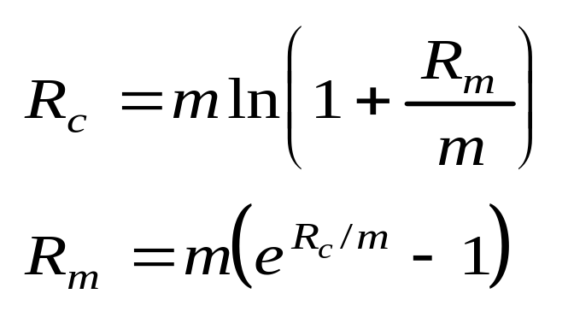
Conversion Formulas (Equations 4.4 and 4.4)
Define
R_{c} : continuously compounded rate
R_{m}: same rate with compounding m times per year

Slide 15
Examples
10% with semiannual compounding is equivalent to 2ln(1.05)=9.758% with continuous compounding
8% with continuous compounding is equivalent to 4(e^{0.08/4} -1)=8.08% with quarterly compounding
Rates used in option pricing are nearly always expressed with continuous compounding

Slide 16
Zero Rates
A zero rate (or spot rate), for maturity T is the rate of interest earned on an investment that provides a payoff only at time T

Slide 17
Example (Table 4.2)
Maturity (years) | Zero rate (cont. comp.
0.5 | 5.0
1.0 | 5.8
1.5 | 6.4
2.0 | 6.8

Slide 18
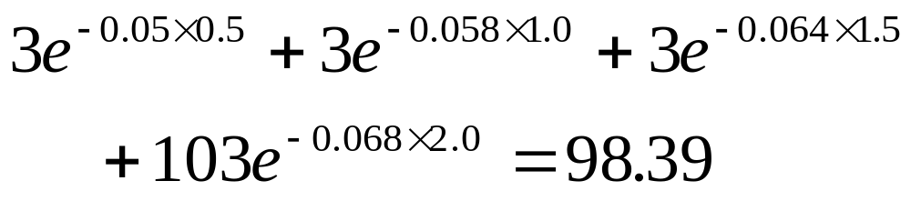
Bond Pricing
To calculate the cash price of a bond we discount each cash flow at the appropriate zero rate
In our example, the theoretical price of a two-year bond providing a 6% coupon semiannually is

Slide 19
Bond Yield
The bond yield is the discount rate that makes the present value of the cash flows on the bond equal to the market price of the bond
Suppose that the market price of the bond in our example equals its theoretical price of 98.39
The bond yield (continuously compounded) is given by solving
to get y=0.0676 or 6.76%.

Slide 20
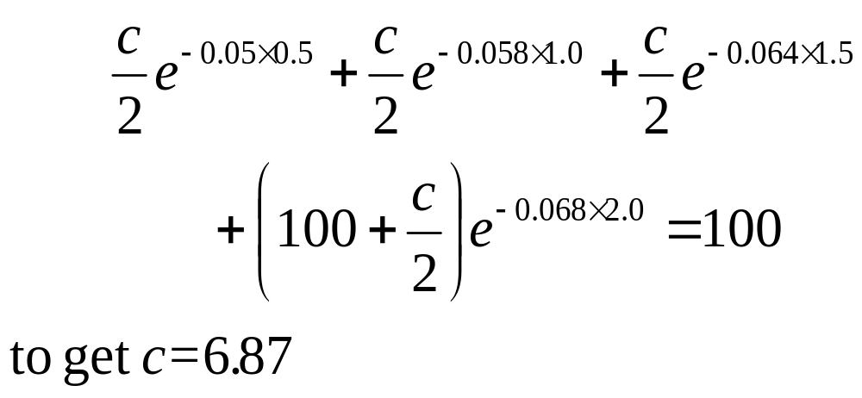
Par Yield
The par yield for a certain maturity is the coupon rate that causes the bond price to equal its face value.
In our example we solve

Slide 21
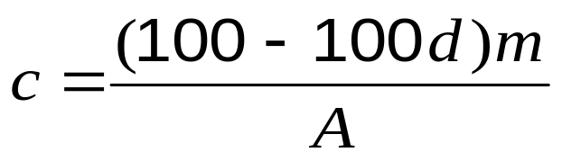
Par Yield continued
In general if m is the number of coupon payments per year, d is the present value of $1 received at maturity and A is the present value of an annuity of $1 on each coupon date
(in our example, m = 2, d = 0.87284, and A = 3.70027)

Slide 22
Data to Determine Zero Curve (Table 4.3)
Bond Principal | Time to Maturity (yrs) | Coupon per year ($)* | Bond price ($)
100 | 0.25 | 0 | 99.6
100 | 0.50 | 0 | 99.0
100 | 1.00 | 0 | 97.8
100 | 1.50 | 4 | 102.5
100 | 2.00 | 5 | 105.0
* Half the stated coupon is paid each year

Slide 23
The Bootstrap Method
An amount 0.4 can be earned on 99.6 during 3 months.
Because 100=99.4e^{0.01603×0.25} the 3-month rate is 1.603% with continuous compounding
Similarly the 6 month and 1 year rates are 2.010% and 2.225% with continuous compounding

Slide 24
The Bootstrap Method continued
To calculate the 1.5 year rate we solve
to get R = 0.02284 or 2.284%
Similarly the two-year rate is 2.416%

Slide 25
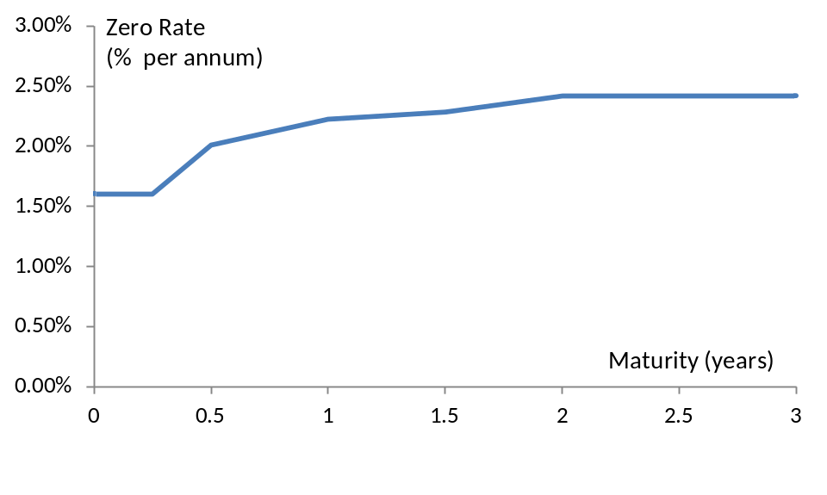
Zero Curve Calculated from the Data (Figure 4.1)

Slide 26
Forward Rates
The forward rate is the future zero rate implied by today’s term structure of interest rates

Slide 27
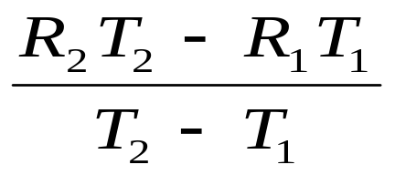
Formula for Forward Rates
Suppose that the zero rates for time periods T₁ and T₂ are R₁ and R₂ with both rates continuously compounded.
The forward rate for the period between times T₁ and T₂ is
This formula is only approximately true when rates are not expressed with continuous compounding

Slide 28
Application of the Formula (Table 4.5)
Year (n) | Zero rate for n-year investment (% per annum) | Forward rate for nth year (% per annum)
1 | 3.0
2 | 4.0 | 5.0
3 | 4.6 | 5.8
4 | 5.0 | 6.2
5 | 5.5 | 6.5

Slide 29
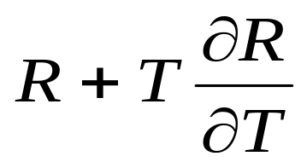
Instantaneous Forward Rate
The instantaneous forward rate for a maturity T is the forward rate that applies for a very short time period starting at T. It is
where R is the T-year rate

Slide 30
Upward vs Downward Sloping
Yield Curve
For an upward sloping yield curve:
Fwd Rate > Zero Rate > Par Yield
For a downward sloping yield curve
Par Yield > Zero Rate > Fwd Rate

Slide 31
Forward Rate Agreement
A forward rate agreement (FRA) is an OTC agreement that the actual rate applicable to a certain period will be exchanged for a predetermined rate, R_{K}, with both being applied to a predetermined principal

Slide 32
Forward Rate Agreement: Key Results
An FRA can be valued by assuming that the forward interest rate, R_{F} , is certain to be realized
This means that the value of an FRA is the present value of the difference between the interest that would be paid at interest at rate R_{F} and the interest that would be paid at rate R_{K}

Slide 33
Example
An FRA entered into some time ago states that a company will receive 5.8% (s.a.) and pay SOFR on a principal of $100 million starting in 1.5 years
Forward SOFR for the period between 1.5 and 2 years is 5% (s.a.)
The 2 year (SOFR) risk-free rate is 4% with continuous compounding
The value of the FRA (in $ millions) is
100×(0.058-0.050) ×0.5×e^{-0.04×2}=0.3692

Slide 34
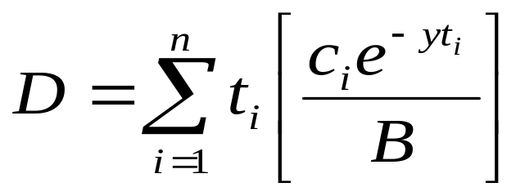
Duration (equation 4.8)
Duration of a bond that provides cash flow c_{i} at time t_{i} is
where B is its price and y is its yield (continuously compounded)

Slide 35
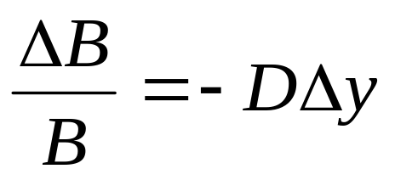
Key Duration Relationship
Duration is important because it leads to the following key relationship between the change in the yield on the bond and the change in its price

Slide 36
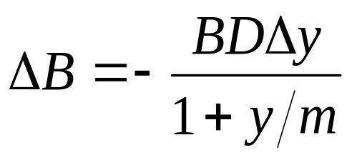
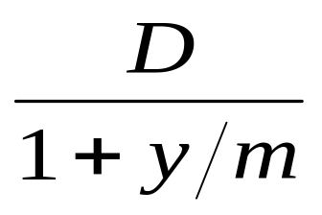
Key Duration Relationship continued
When the yield y is expressed with compounding m times per year
The expression
is referred to as the “modified duration”

Slide 37
Bond Portfolios
The duration for a bond portfolio is the weighted average duration of the bonds in the portfolio with weights proportional to prices
The key duration relationship for a bond portfolio describes the effect of small parallel shifts in the yield curve
What exposures remain if duration of a portfolio of assets equals the duration of a portfolio of liabilities?

Slide 38
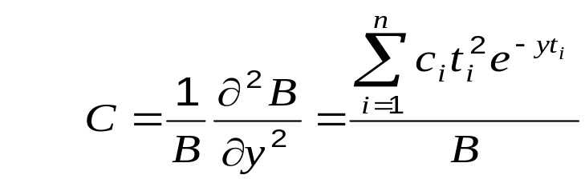
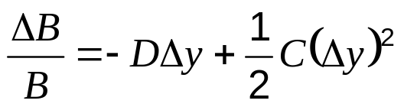
Convexity (equation 4.14)
The convexity, C, of a bond is defined as
This leads to a more accurate relationship
When used for bond portfolios it allows larger shifts in the yield curve to be considered, but the shifts still have to be parallel

Slide 39
Theories of the Term Structure
Expectations Theory: forward rates equal expected future zero rates
Market Segmentation: short, medium and long rates determined independently of each other
Liquidity Preference Theory: forward rates higher than expected future zero rates

Slide 40
Liquidity Preference Theory
(Table 4.7)
Suppose that the outlook for rates is flat and you have been offered the following choices
Which would you choose as a depositor? Which for your mortgage?
Maturity | Deposit rate | Mortgage rate
1 year | 3% | 6%
5 year | 3% | 6%

Slide 41
Liquidity Preference Theory cont (Table 4.8)
To match the maturities of borrowers and lenders a bank has to increase long rates above expected future short rates
In our example the bank might offer
Maturity | Deposit rate | Mortgage rate
1 year | 3% | 6%
5 year | 4% | 7%

